Slide 1
Git Installation Guide: Enabling Version Control with GitLab
McMaster Automotive Resource Centre (MARC)

Slide 2
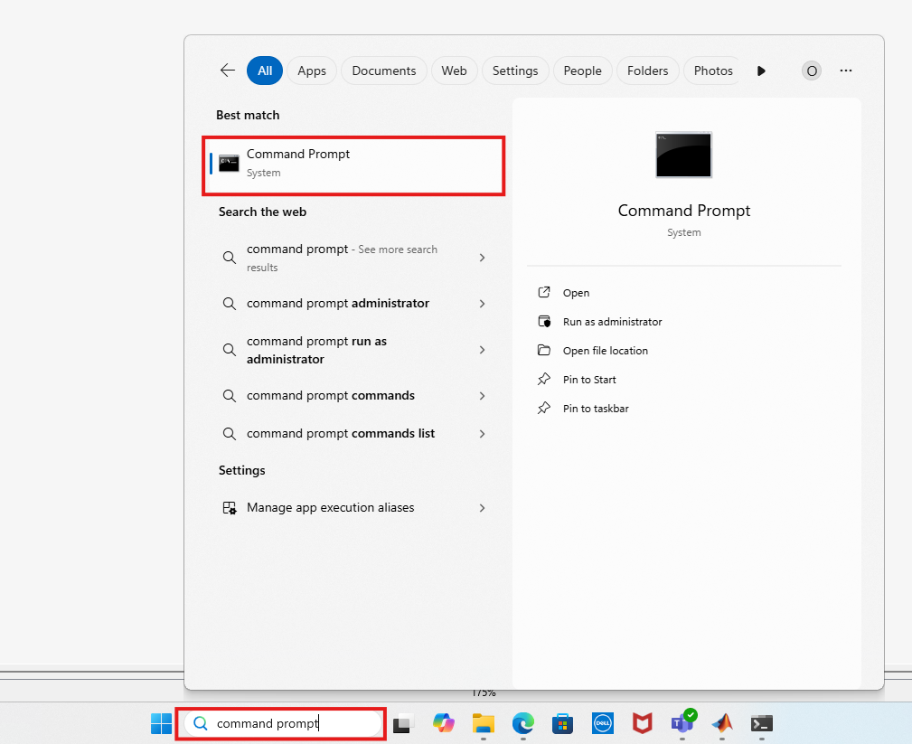
Git Installation Guide: Enabling Version Control with GitLab
Check if git is installed on your computer by going to a shell program, for example, cmd for Windows. To do that, search for Command Prompt and open it by double-clicking it.

Slide 3
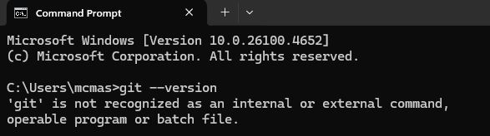
Git Installation Guide: Enabling Version Control with GitLab
2. Type git --version and press enter to verify if git is installed. If the return message is "'git' is not recognized as an internal or external command, operable program or batch file.", it means git is not installed in the computer.

Slide 4
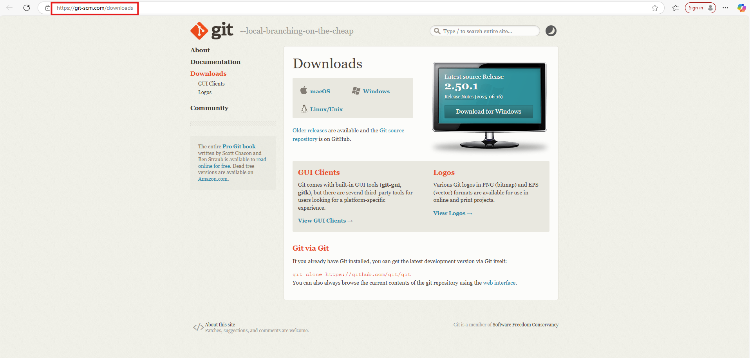
Git Installation Guide: Enabling Version Control with GitLab
3. If git is not installed in the computer, go to the official Git website: https://git-scm.com/downloads using a web browser.

Slide 5
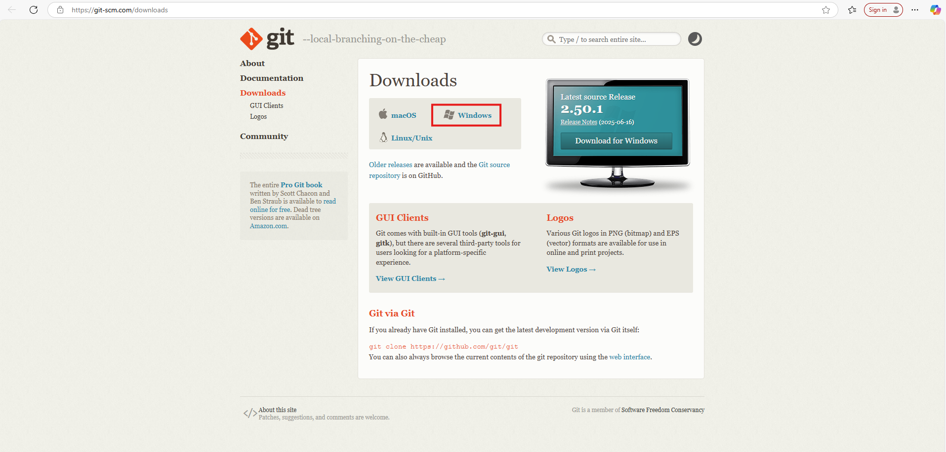
Git Installation Guide: Enabling Version Control with GitLab
4. Choose the OS compatible to the computer. For example, I am downloading in a Windows machine.

Slide 6
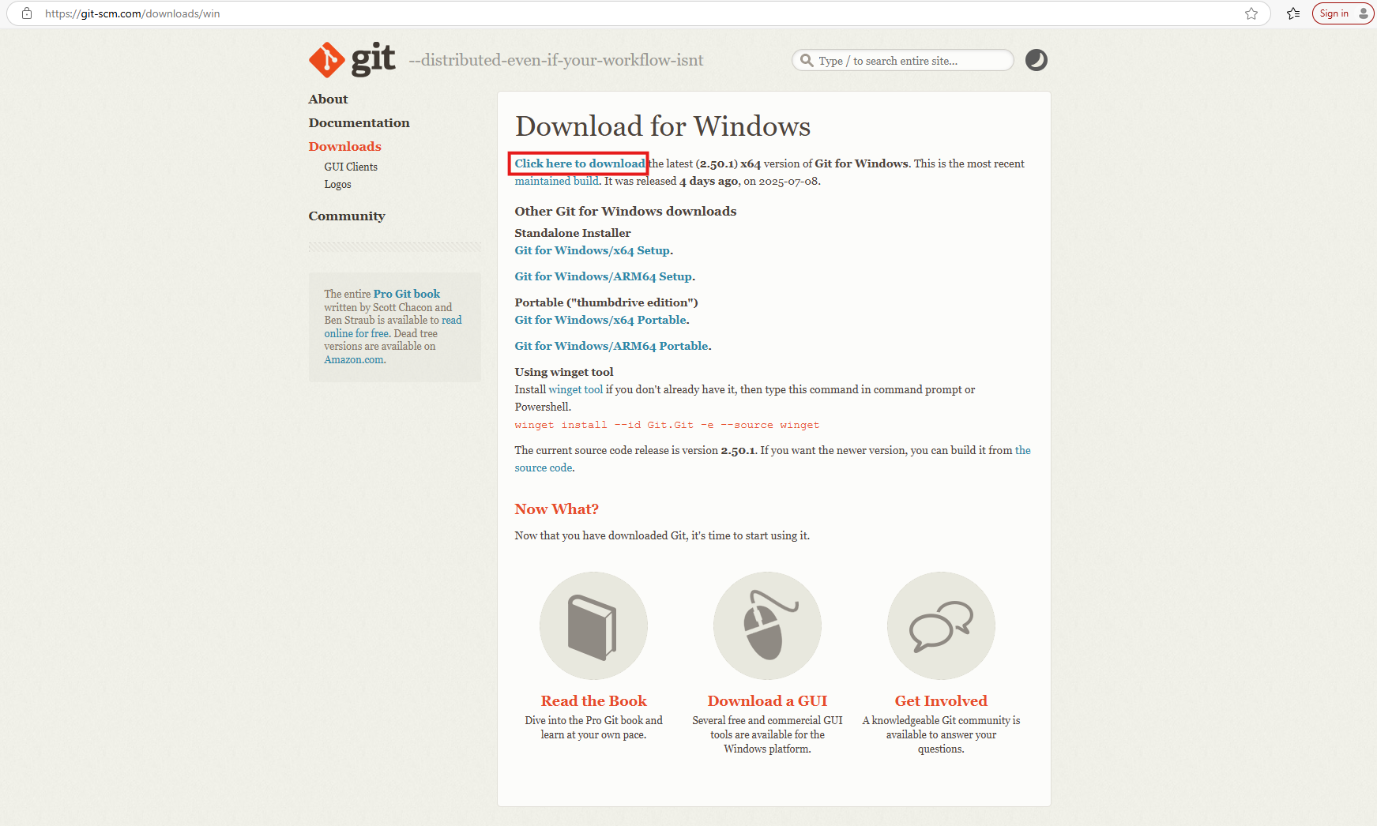
Git Installation Guide: Enabling Version Control with GitLab
5. Press on the text written "Click here to download" to start the download.

Slide 7
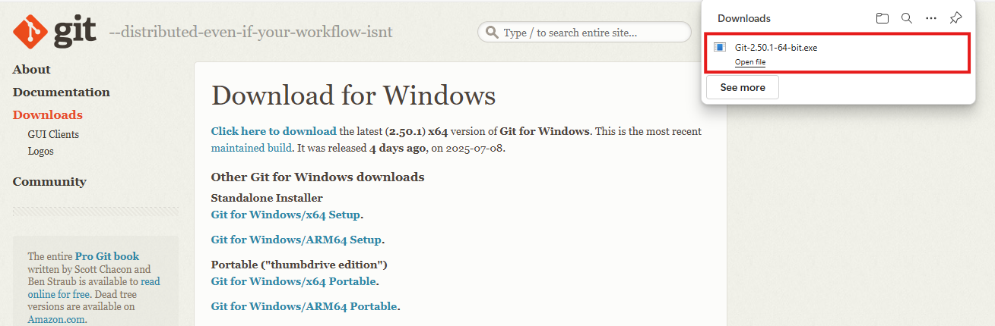
Git Installation Guide: Enabling Version Control with GitLab
6. Double-click the .exe file to execute the file.

Slide 8
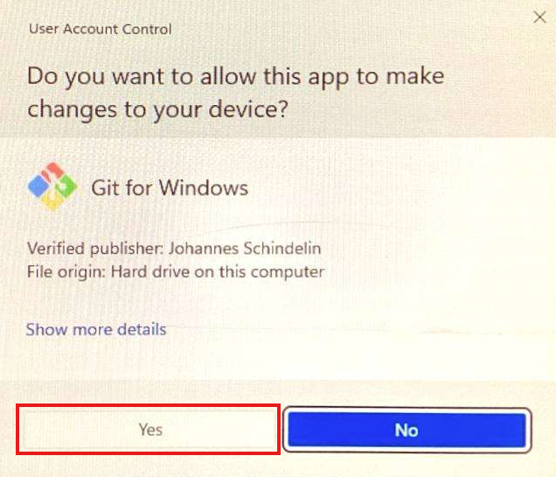
Git Installation Guide: Enabling Version Control with GitLab
7. In the pop-up window, press Yes to allow this application to make changes to the computer.

Slide 9
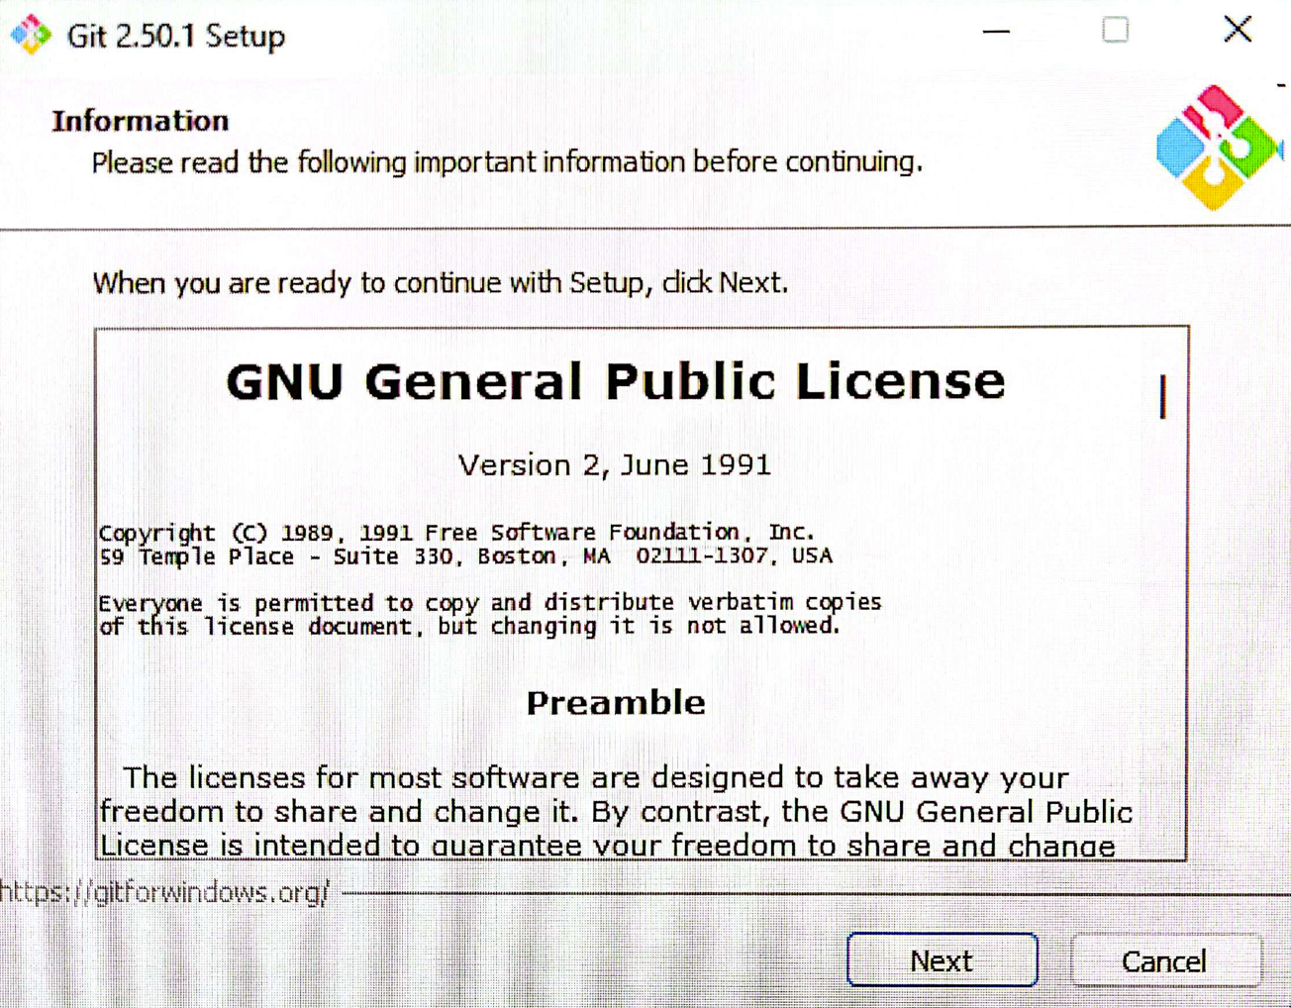
Git Installation Guide: Enabling Version Control with GitLab
8. Next, there should be around 15-16 pop-windows to setup Git. Keep all of them their default configuration. Press Next to all pop-up windows.

Slide 10
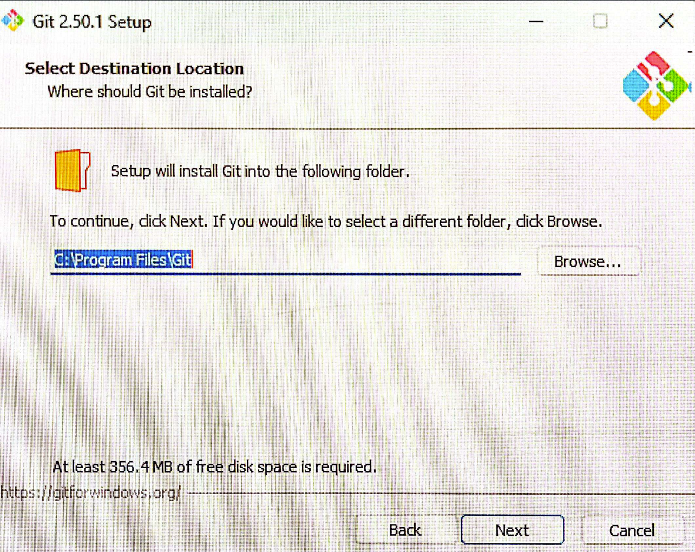
Git Installation Guide: Enabling Version Control with GitLab
9.

Slide 11
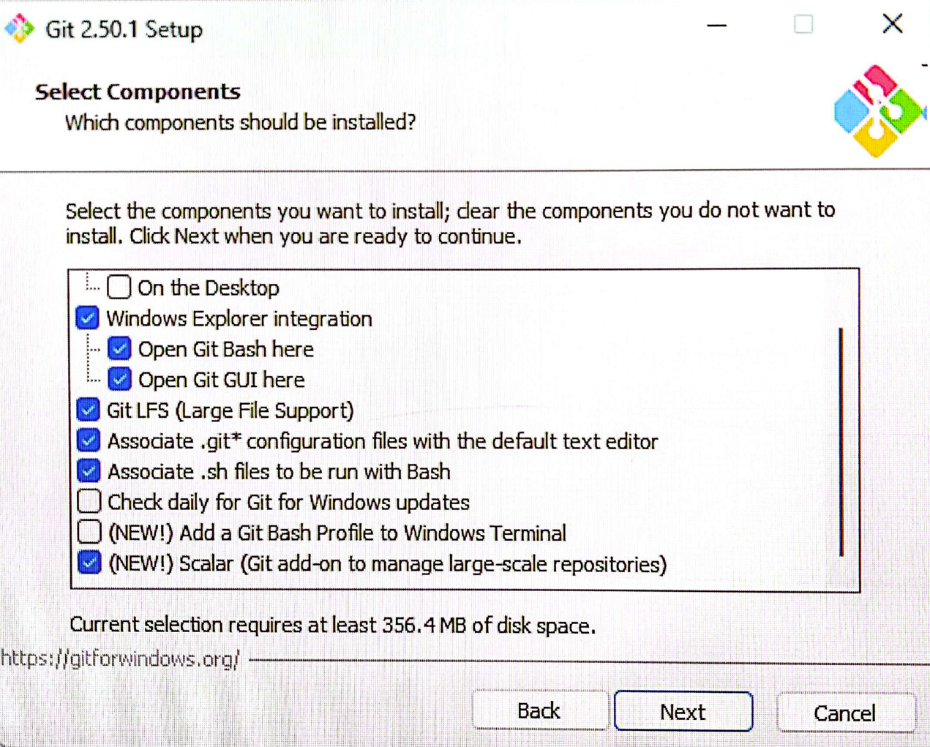
Git Installation Guide: Enabling Version Control with GitLab
10.

Slide 12
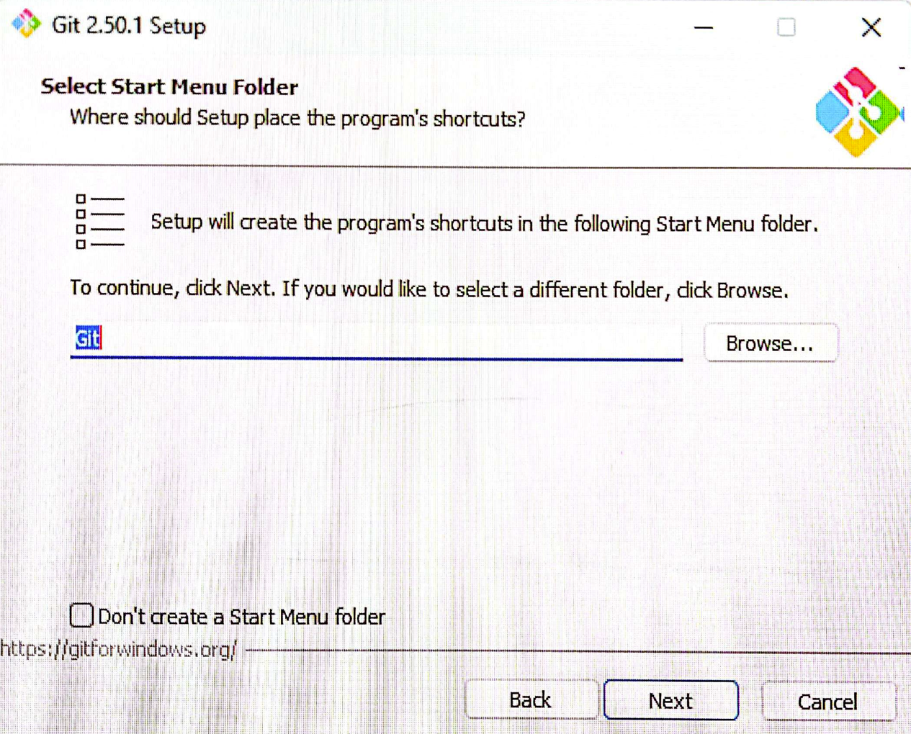
Git Installation Guide: Enabling Version Control with GitLab
11.

Slide 13
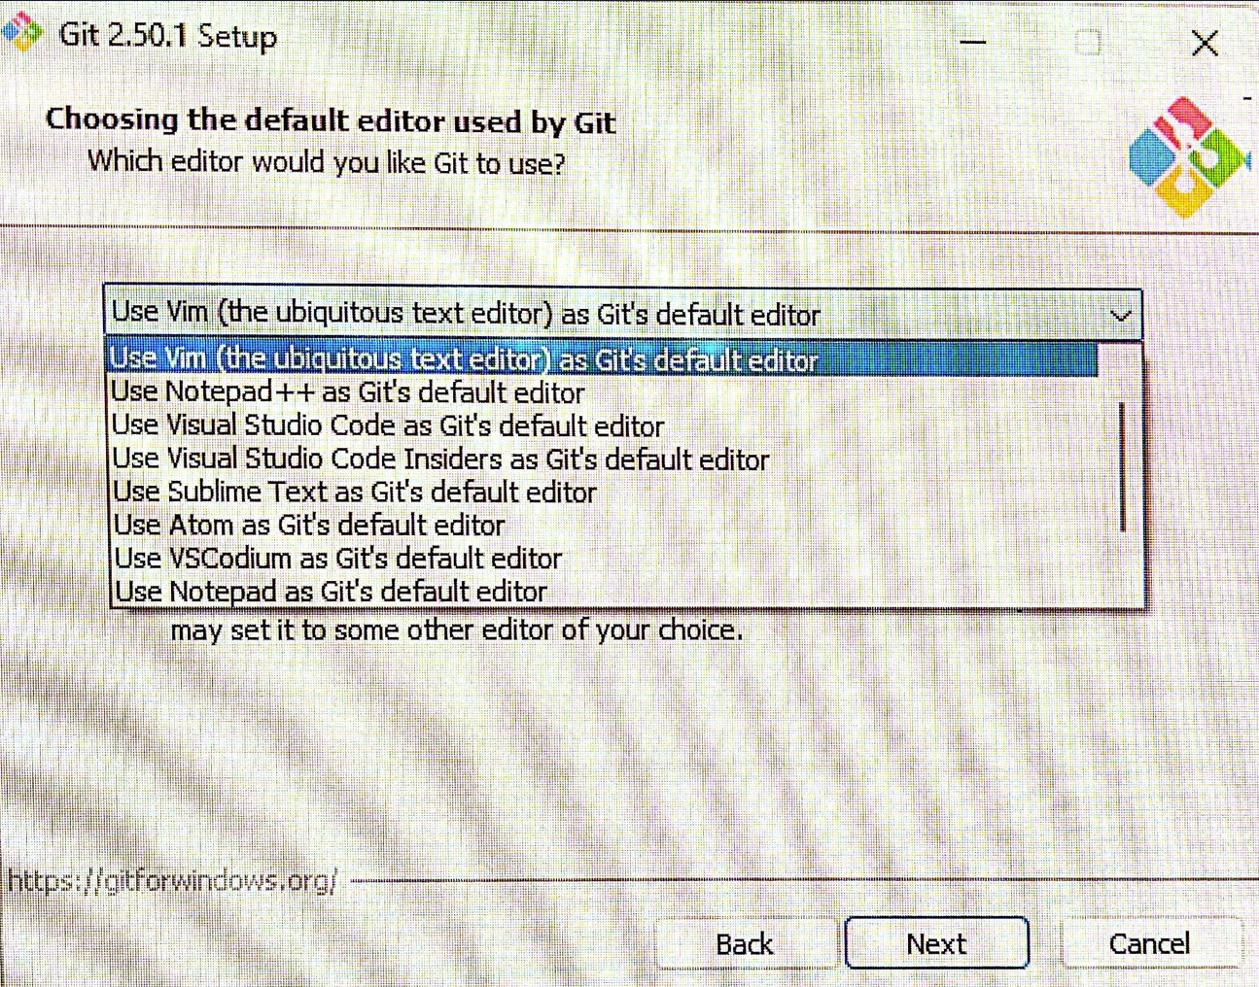
Git Installation Guide: Enabling Version Control with GitLab
12. Git's default editor is Vim. Based on your preference, choose the one that works best for you, i.e., VS Code, Notepad++, etc.

Slide 14
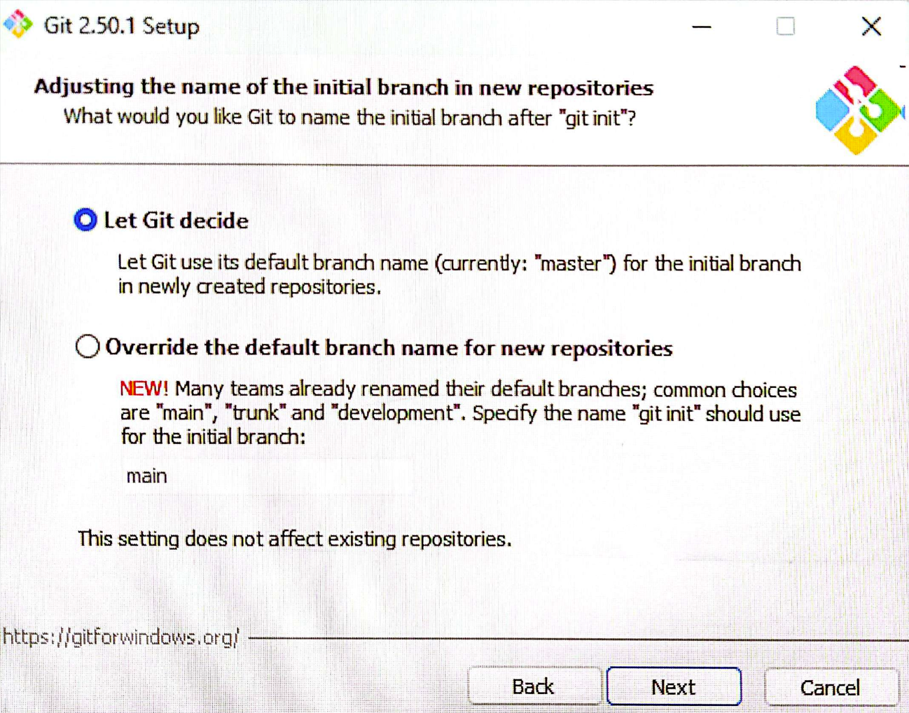
Git Installation Guide: Enabling Version Control with GitLab
13.

Slide 15
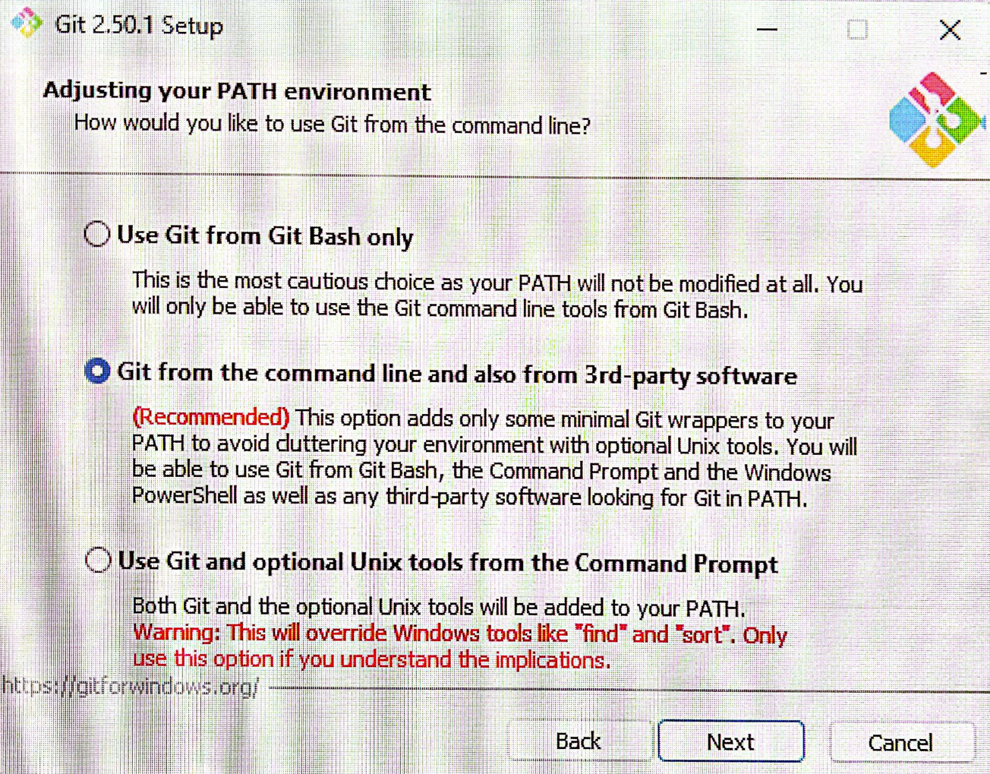
Git Installation Guide: Enabling Version Control with GitLab
14.

Slide 16
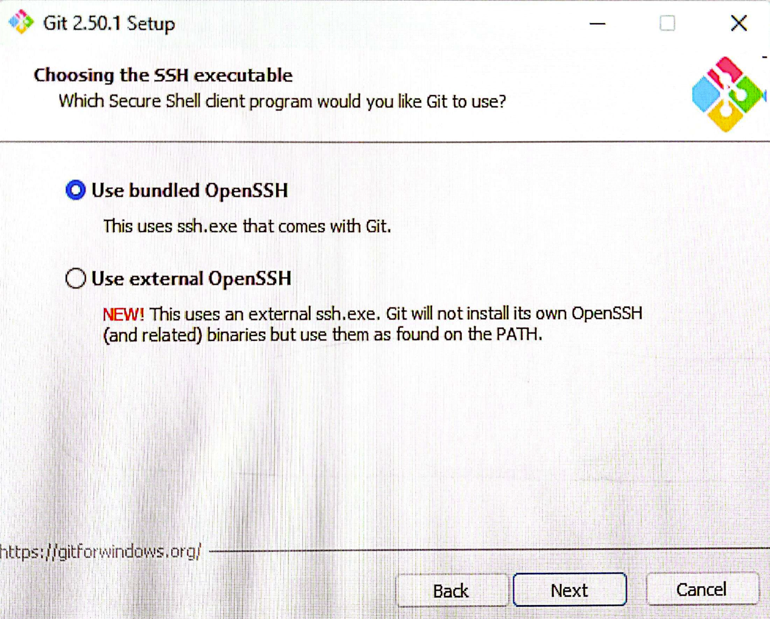
Git Installation Guide: Enabling Version Control with GitLab
15.

Slide 17
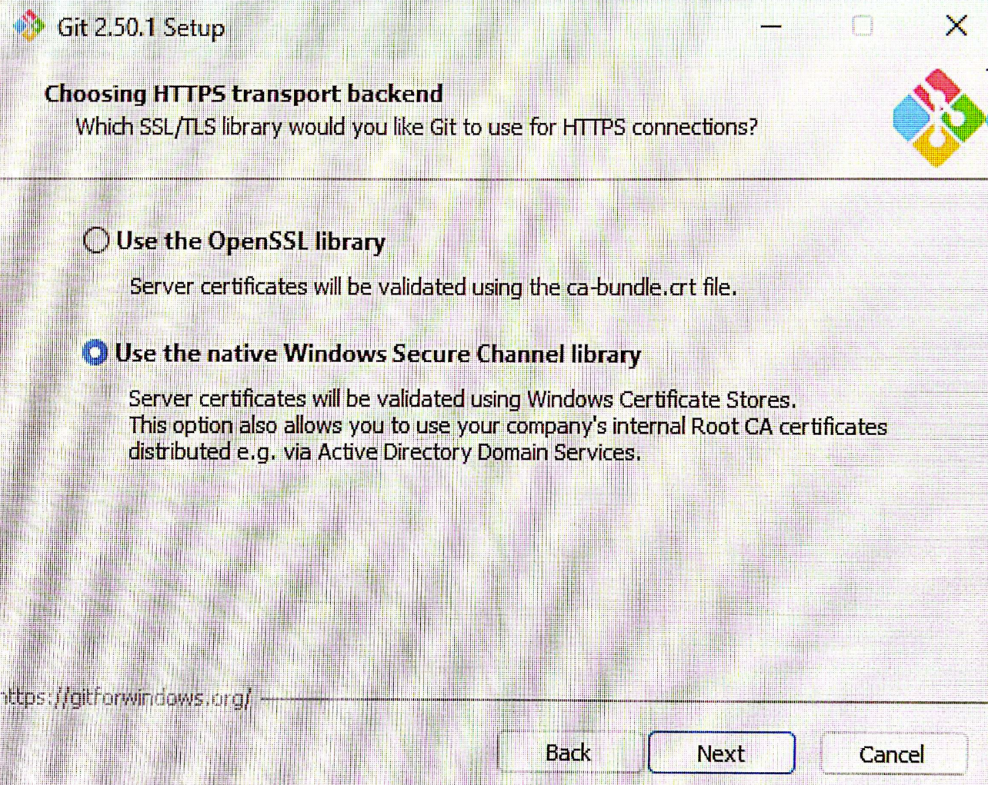
Git Installation Guide: Enabling Version Control with GitLab
16.

Slide 18
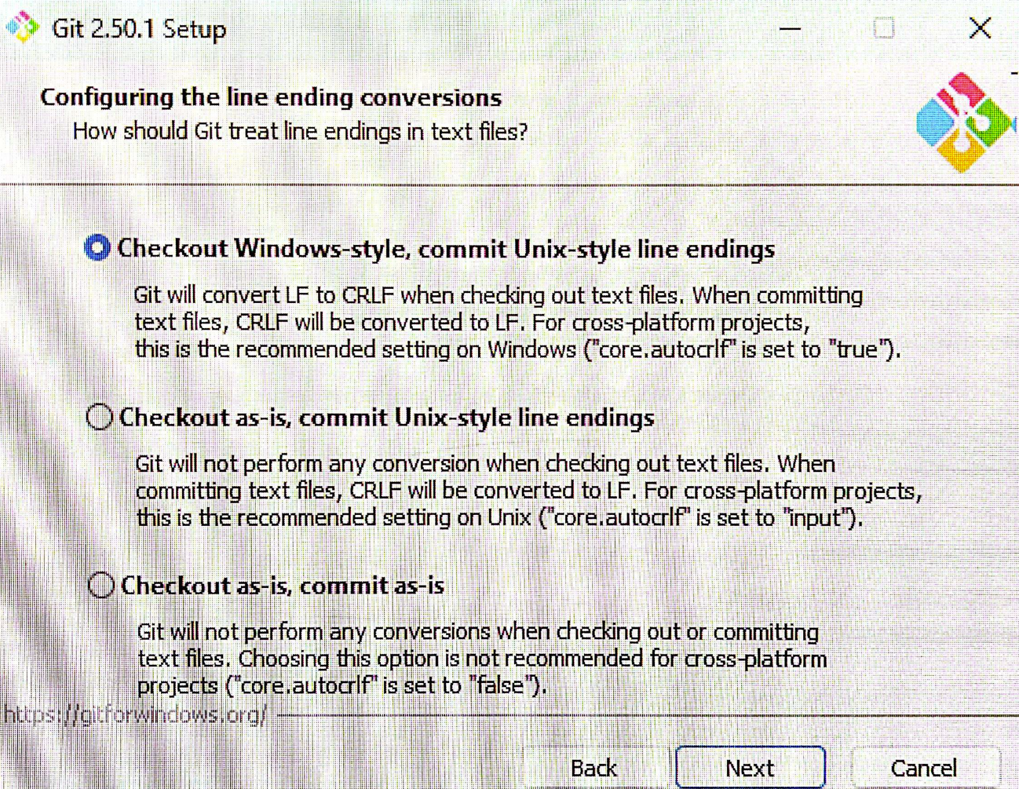
Git Installation Guide: Enabling Version Control with GitLab
17.

Slide 19
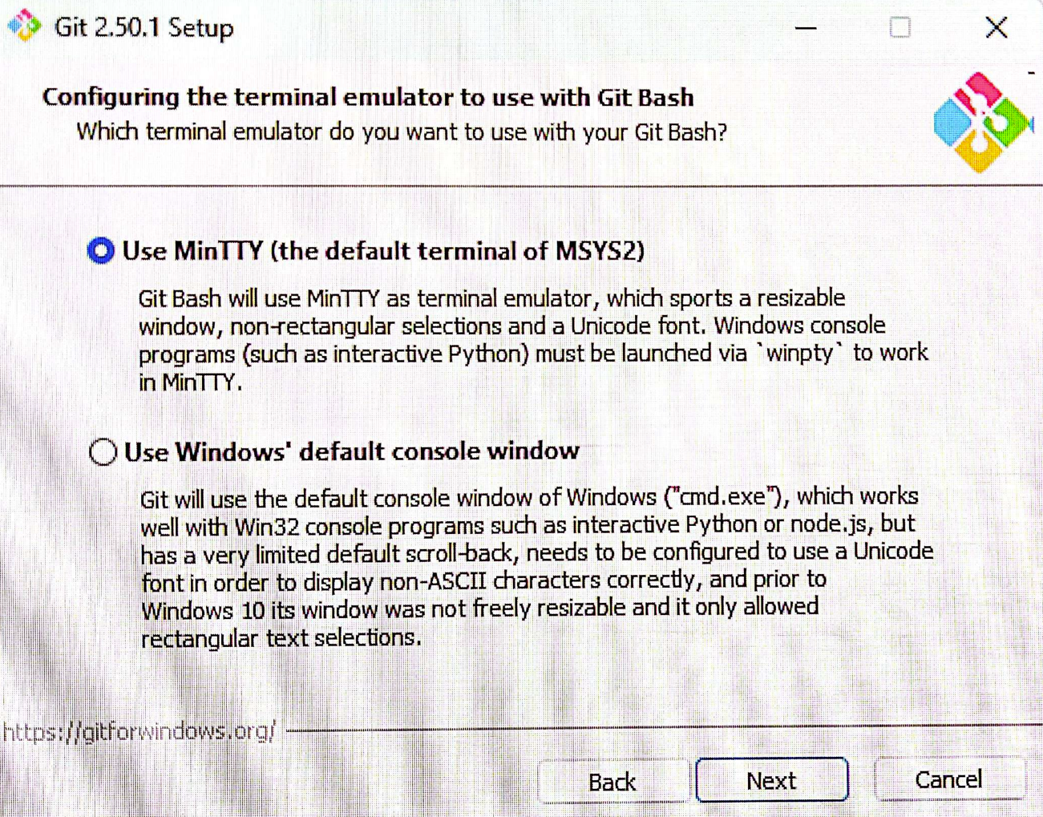
Git Installation Guide: Enabling Version Control with GitLab
18.

Slide 20
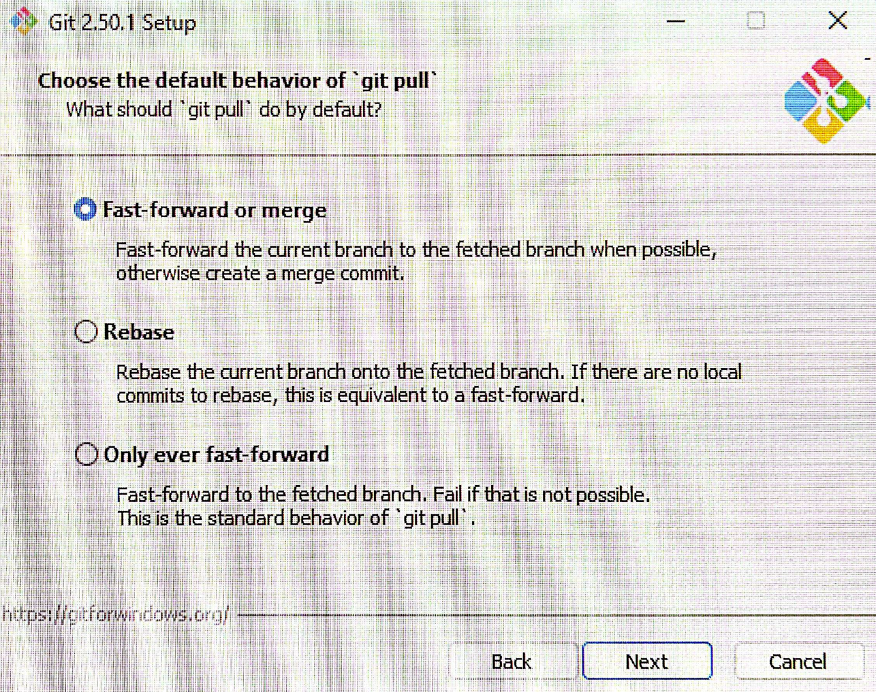
Git Installation Guide: Enabling Version Control with GitLab
19.

Slide 21
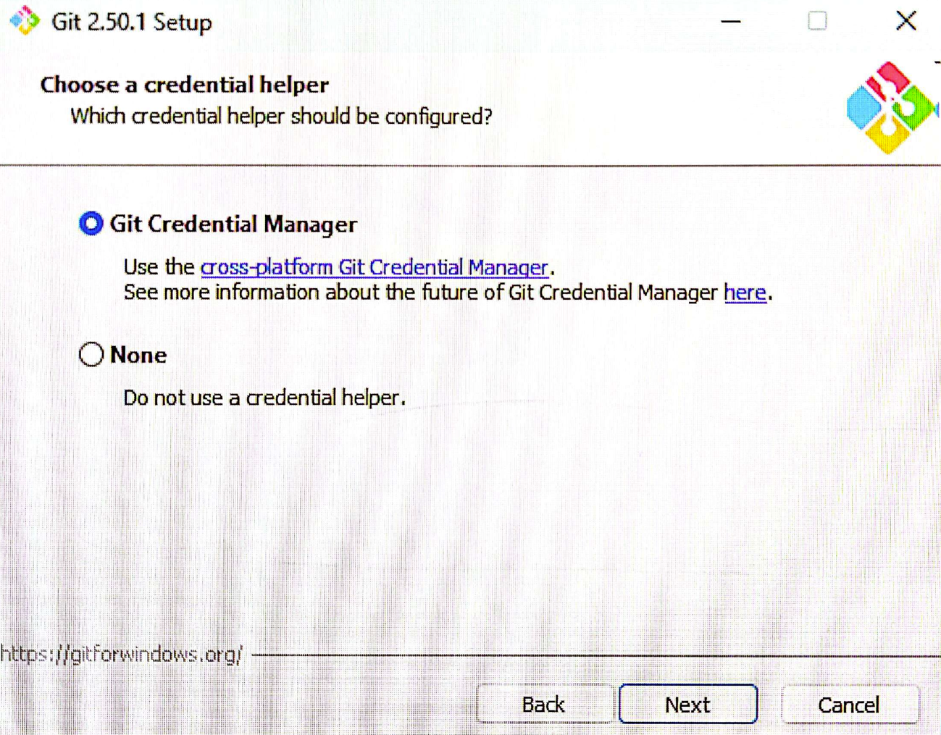
Git Installation Guide: Enabling Version Control with GitLab
20.

Slide 22
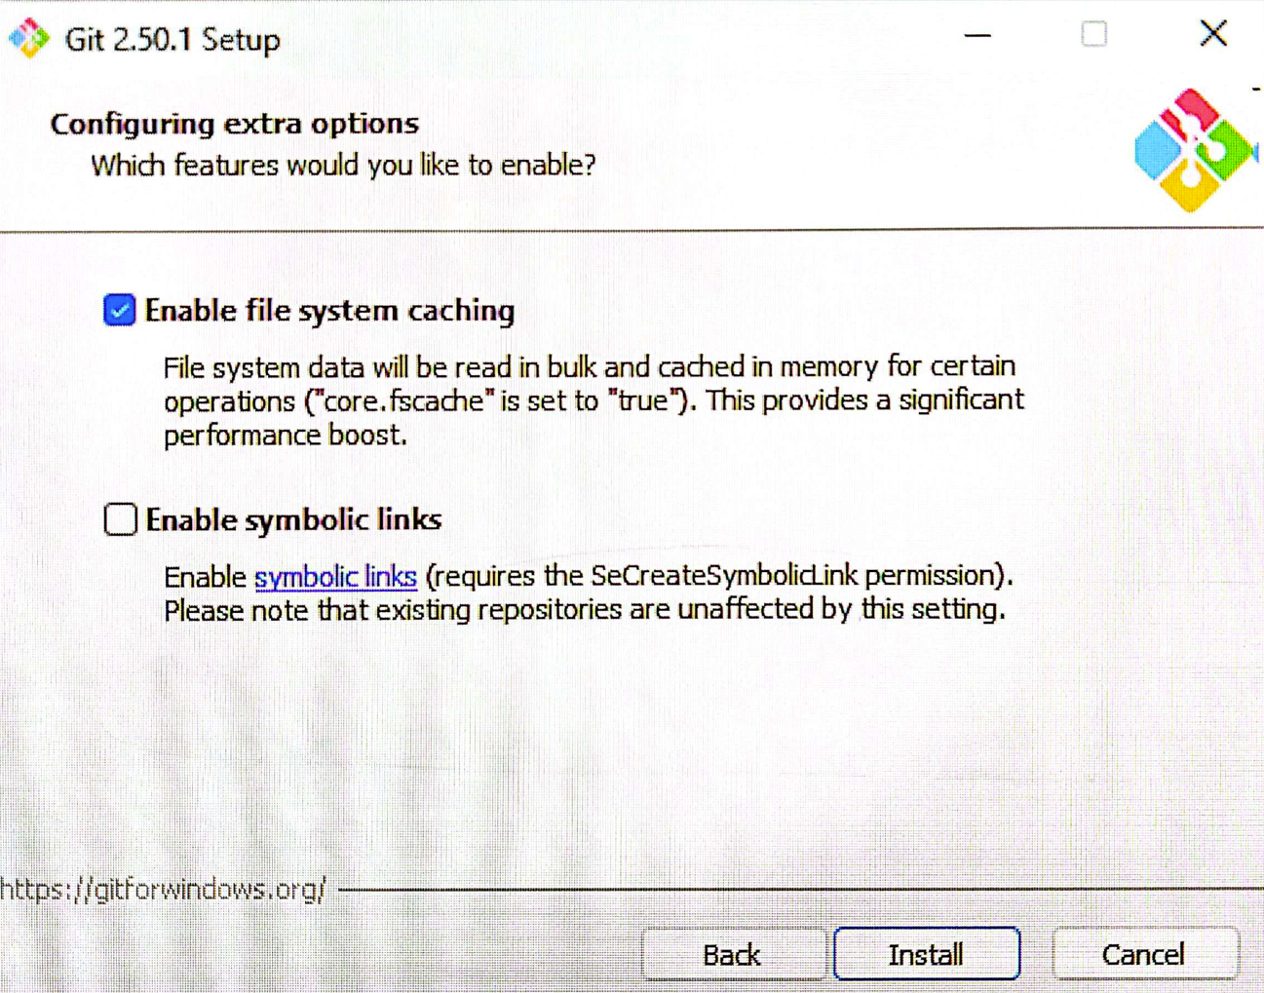
Git Installation Guide: Enabling Version Control with GitLab
21. This is the last Git Setup pop-up window. Press Install.

Slide 23
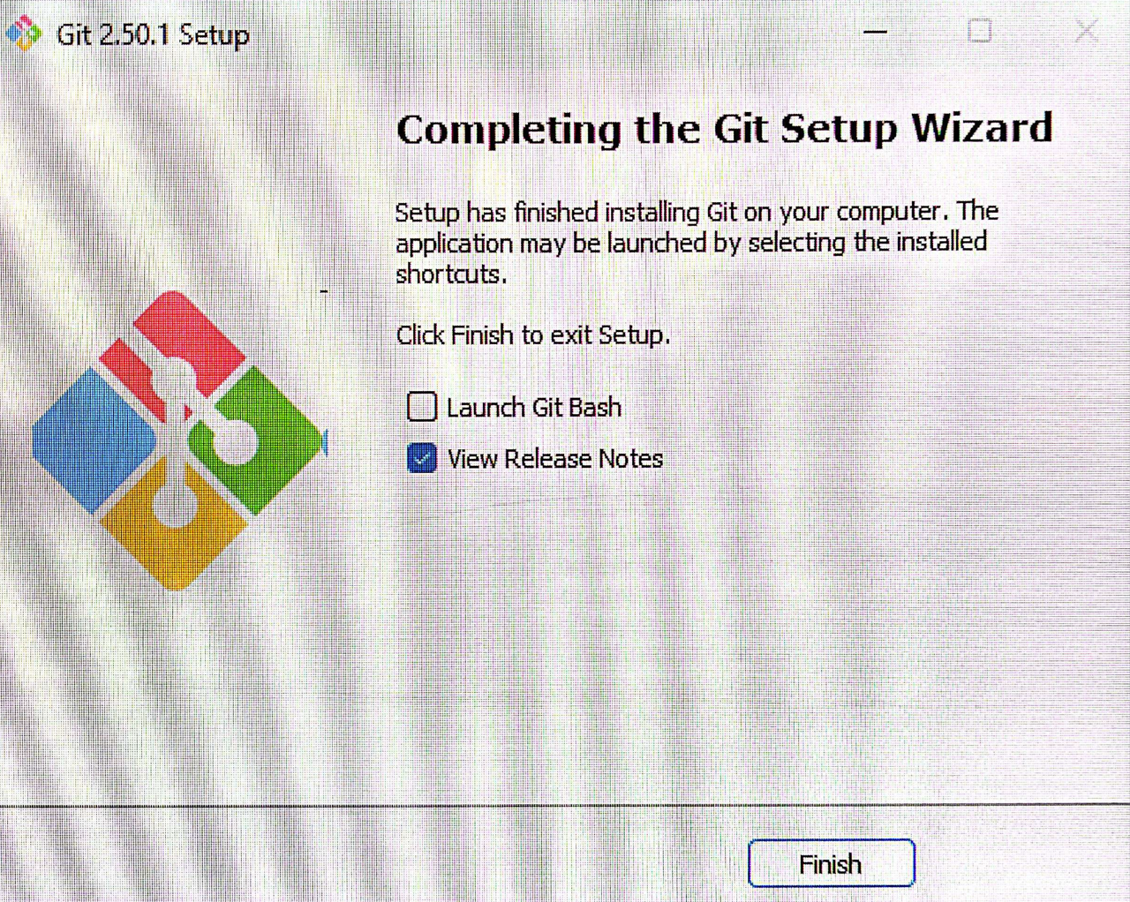
Git Installation Guide: Enabling Version Control with GitLab
22. After the installation is complete, press Finish.

Slide 24
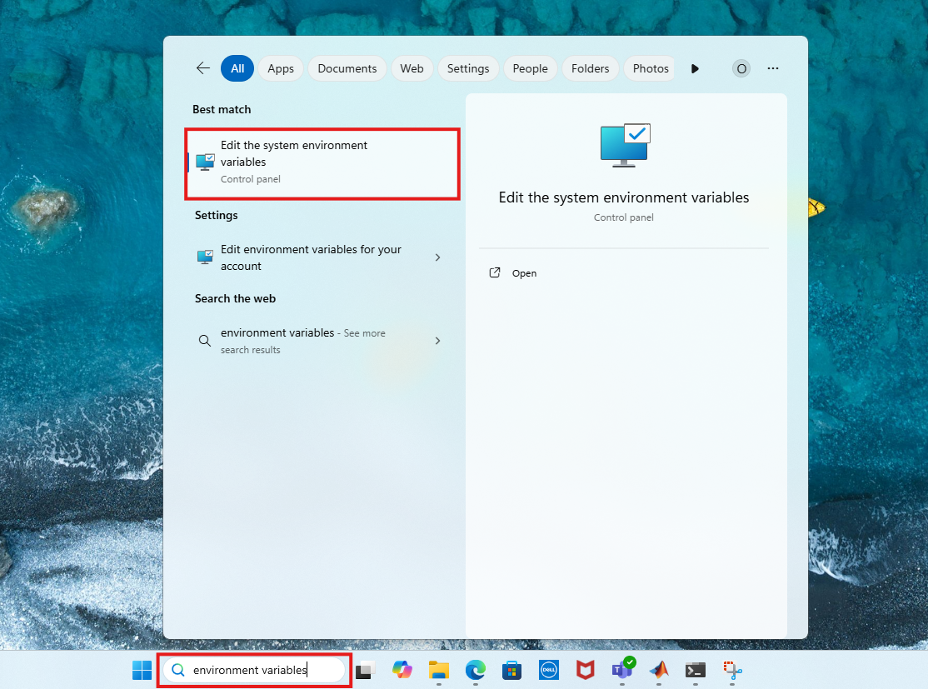
Git Installation Guide: Enabling Version Control with GitLab
23. Next, verify if the full path of the directory where git.exe is added in your computer is added to the system environment variable. Adding the Git installation folder to the system PATH allows you to run git from any terminal or command prompt by telling Windows where to find git.exe. To do that, search for environment variables and open it.

Slide 25
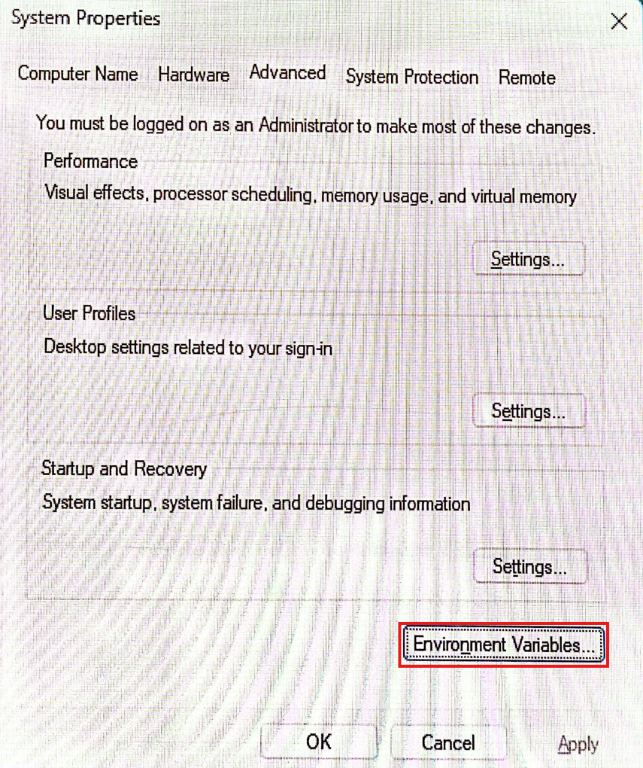
Git Installation Guide: Enabling Version Control with GitLab
24. Go to Environment Variables.

Slide 26
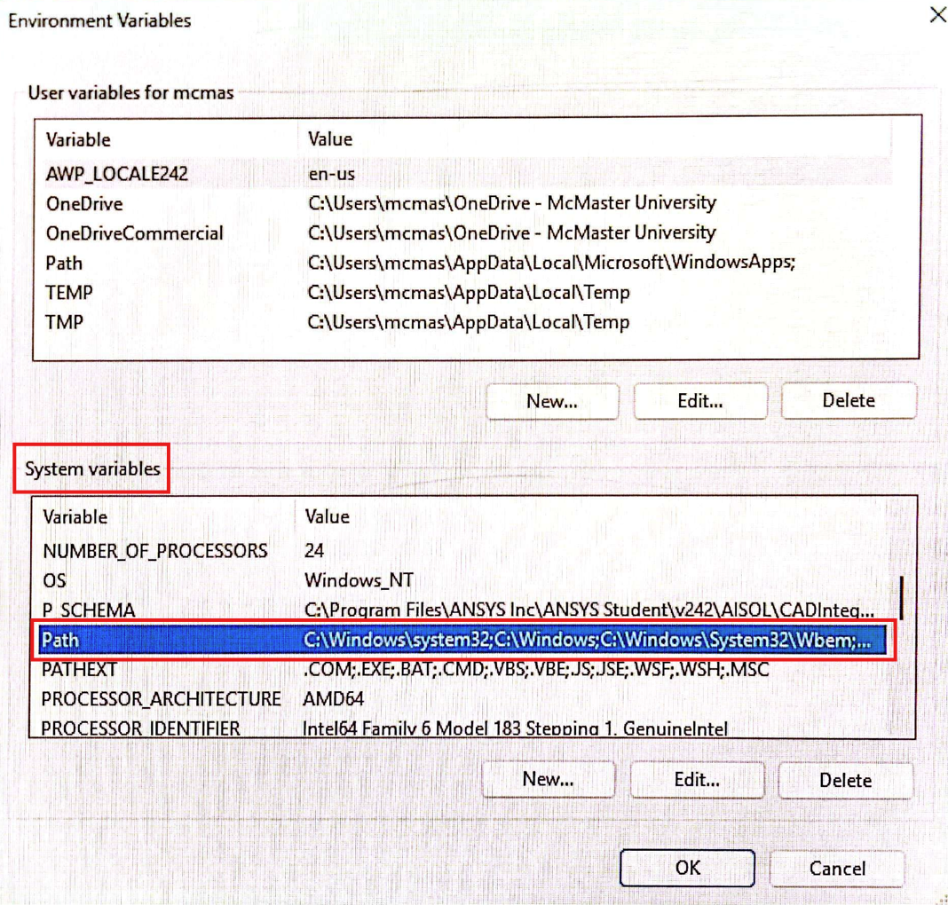
Git Installation Guide: Enabling Version Control with GitLab
25. From System variables, scroll-down and double-click Path.

Slide 27
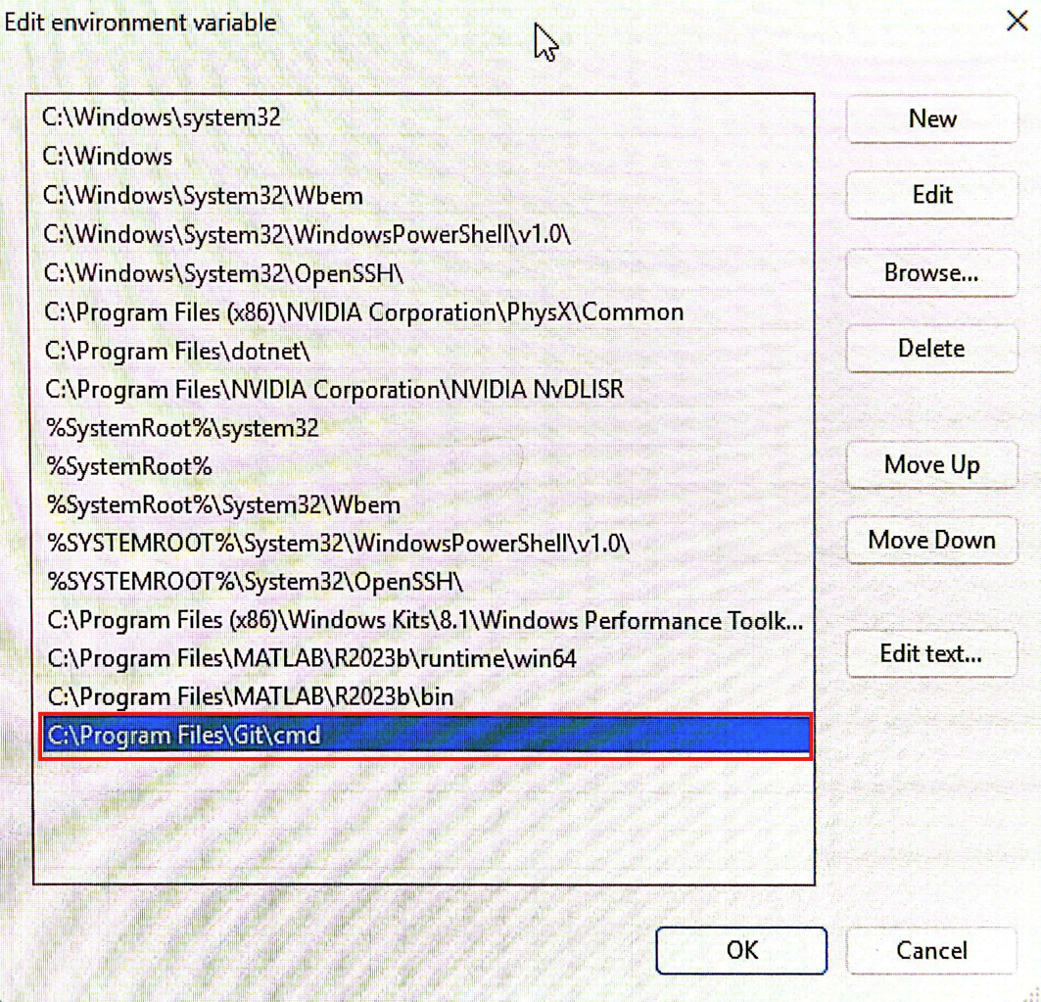
Git Installation Guide: Enabling Version Control with GitLab
26. The correct directory should already be there, as indicated during Git Setup earlier. Press OK.

Slide 28
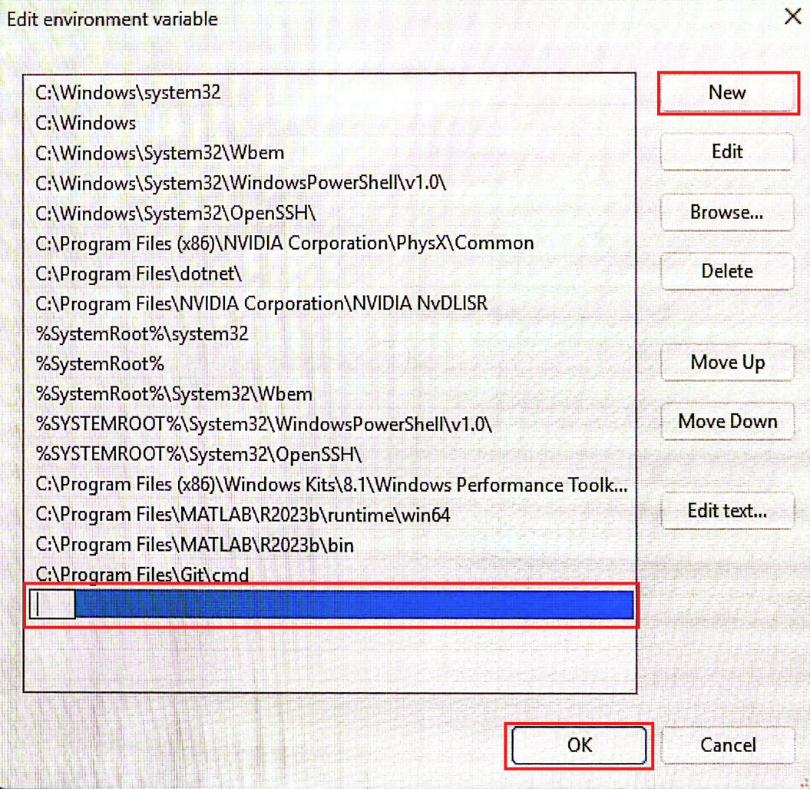
Git Installation Guide: Enabling Version Control with GitLab
27. In case the correct path is not added, you can manually add it by pressing New. It will create a new empty field. Over there, copy-paste the correct directory where you previously indicated Git to be installed. Then, press OK.

Slide 29
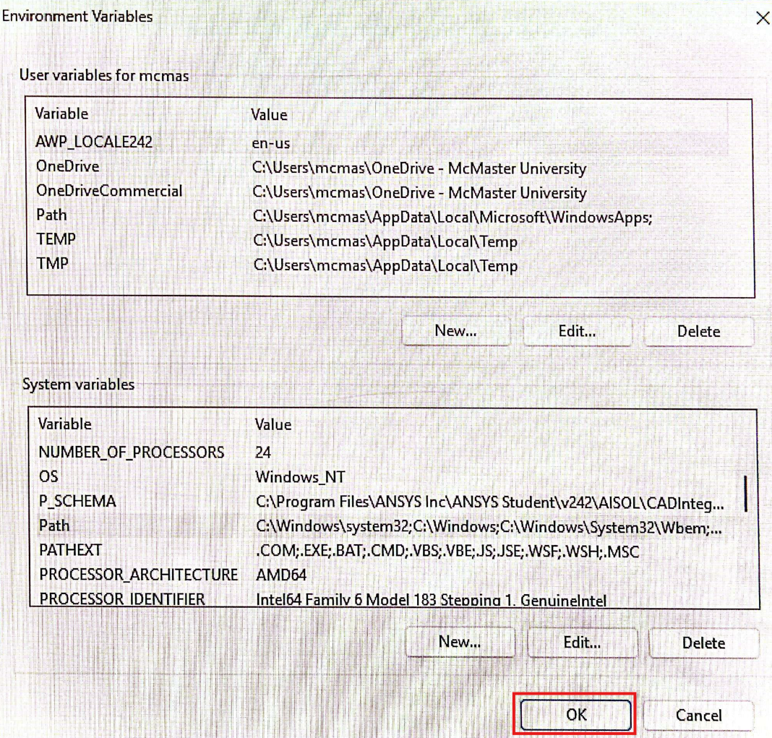
Git Installation Guide: Enabling Version Control with GitLab
28. Press OK.

Slide 30
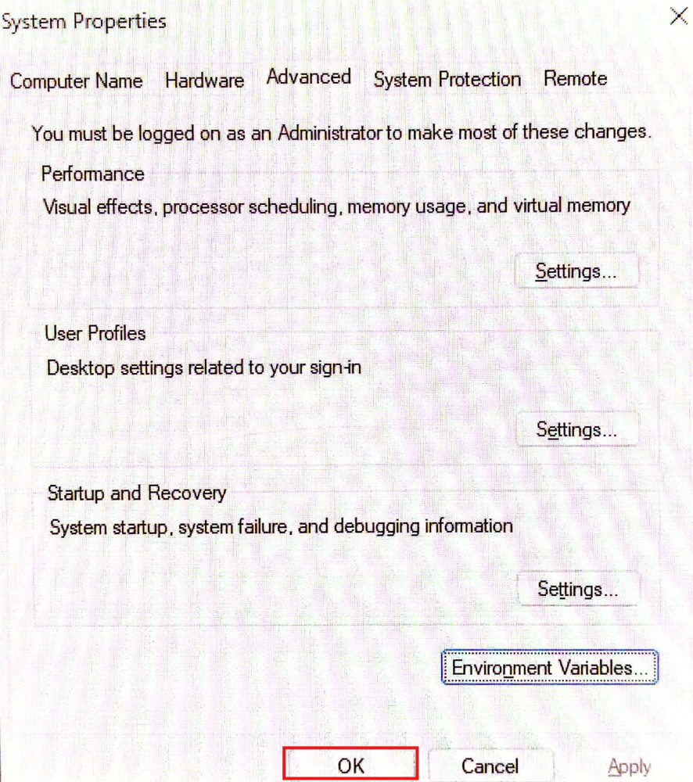
Git Installation Guide: Enabling Version Control with GitLab
29. Press OK.

Slide 31
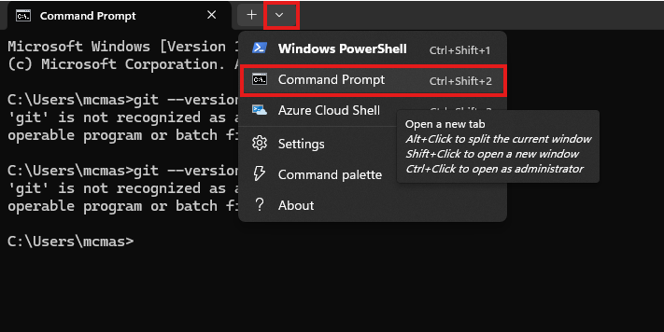
Git Installation Guide: Enabling Version Control with GitLab
30. Now, the Command Prompt should recognize 'git'. Take a new Command Prompt tab from the top drop-down menu.

Slide 32
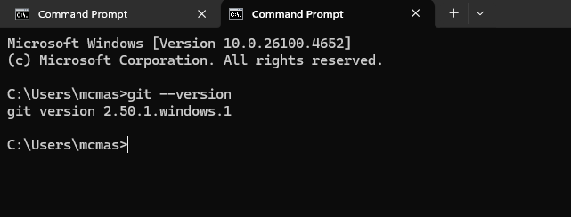
Git Installation Guide: Enabling Version Control with GitLab
31. Remember, at the very beginning we used git --version. Last time git was unrecognizable by the Command Prompt. But this time the return message should show the git version that we just installed. It confirms that git is ready to use.

Slide 33
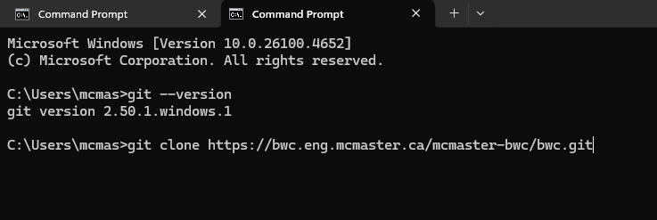
Git Installation Guide: Enabling Version Control with GitLab
32. Now, to clone a repository, type git clone <remote repository url> and press enter. Replace <remote repository url> with an actual URL, as shown below.

Slide 34
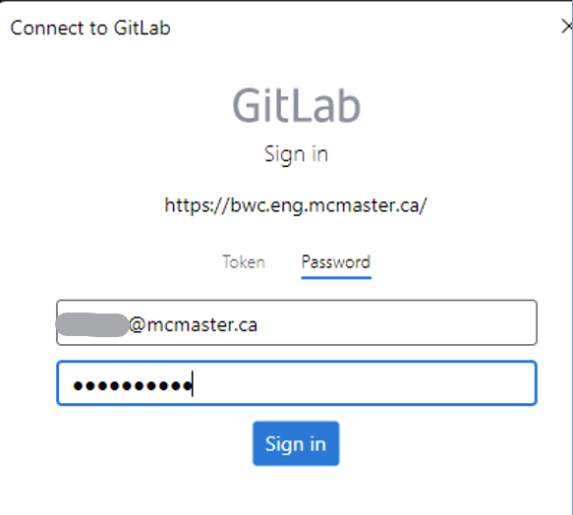
Git Installation Guide: Enabling Version Control with GitLab
33. Since it is the first time using git after installation, a sign-in window will pop up. Use the correct email address and password to sign in to a Git account, i.e., the screenshot below shows what the sign-in pop-up window looks like for GitLab.

Slide 35
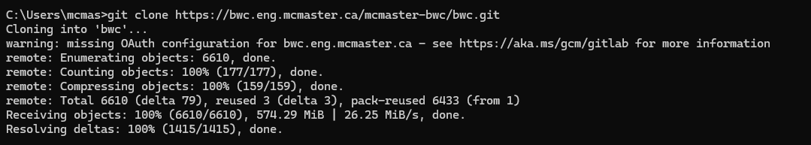
Git Installation Guide: Enabling Version Control with GitLab
34. A command line output showing that the git clone is successful, which means the git clone command successfully copied the remote repository to your local machine/computer.

Slide 36
Git Installation Guide: Enabling Version Control with GitLab
Useful Git Commands: Setup and Configuration
Command | Purpose
git config --global user.name "Your Name" | Set your Git username
git config --global user.email "you@example.com" | Set your Git email
git config --global core.editor nano | Set your preferred text editor (e.g., nano, code, vim)
git config --list | Show all Git config settings

Slide 37
Daily Git Workflow Example
>> git status # See changes made and files staged/untracked
>> git pull # Fetch and merge changes from remote
# edit files
>> git add . # Stage all changes in the current directory
>> git commit -m "Implemented feature X“
# Commit changes with a message
>> git push # Upload local changes to remote
Daily Git Commands

Slide 38
Useful Git Commands
Command | Purpose
git config --global user.name "Your Name" | Set your Git username
git config --global user.email "you@example.com" | Set your Git email
git config --global core.editor nano | Set your preferred text editor (e.g., nano, code, vim)
git config --list | Show all Git config settings
Setup and Configuration

Slide 39
Useful Git Commands
Command | Purpose
git init | Create a new Git repository in the current folder
git clone <url> | Copy an existing repo to your local system
git status | See changes made and files staged/untracked
git log | Show the commit history
Repository Management

Slide 40
Useful Git Commands
Command | Purpose
git add <file> | Stage a file for commit
git add . | Stage all changes in the current directory
git commit -m "message" | Commit changes with a message
git commit -am "message" | Add and commit tracked files in one step (only works for tracked files)
Adding & Committing

Slide 41
Useful Git Commands
Command | Purpose
git branch | List local branches
git branch <branch-name> | Create a new branch
git checkout <branch-name> | Switch to a branch
git switch <branch-name> | (Alternative to checkout) switch to a branch
git switch -c <branch-name> | Create and switch to a new branch
git merge <branch> | Merge another branch into current one
Branching

Slide 42
Useful Git Commands
Command | Purpose
git remote -v | View linked remote repositories (like GitHub)
git push | Upload local changes to remote
git pull | Fetch and merge changes from remote
git fetch | Download changes without merging
git push -u origin <branch> | Push a new branch to remote and track it
Remote Repositories

Slide 43
Useful Git Commands
Command | Purpose
git restore <file> | Undo changes in a file (not staged)
git restore --staged <file> | Unstage a file
git reset --hard | Reset all changes (destructive)
git reset --soft HEAD~1 | Undo last commit but keep changes staged
git reset --hard HEAD~2 | Delete last 2 commits and discard changes
git revert <commit> | Create a new commit that undoes an earlier one safely
Undoing Changes

Slide 44
Useful Git Commands
Command | Purpose
git diff | See line-by-line changes
git stash | Temporarily save (stash) uncommitted changes
git stash pop | Reapply stashed changes
git tag <tag-name> | Create a tag (e.g., for a release)
Other Useful Commands

Slide 45
Thank you
McMaster Automotive Resource Centre (MARC)
45

